Slide 1
DEMAND FORECASTING

Slide 2
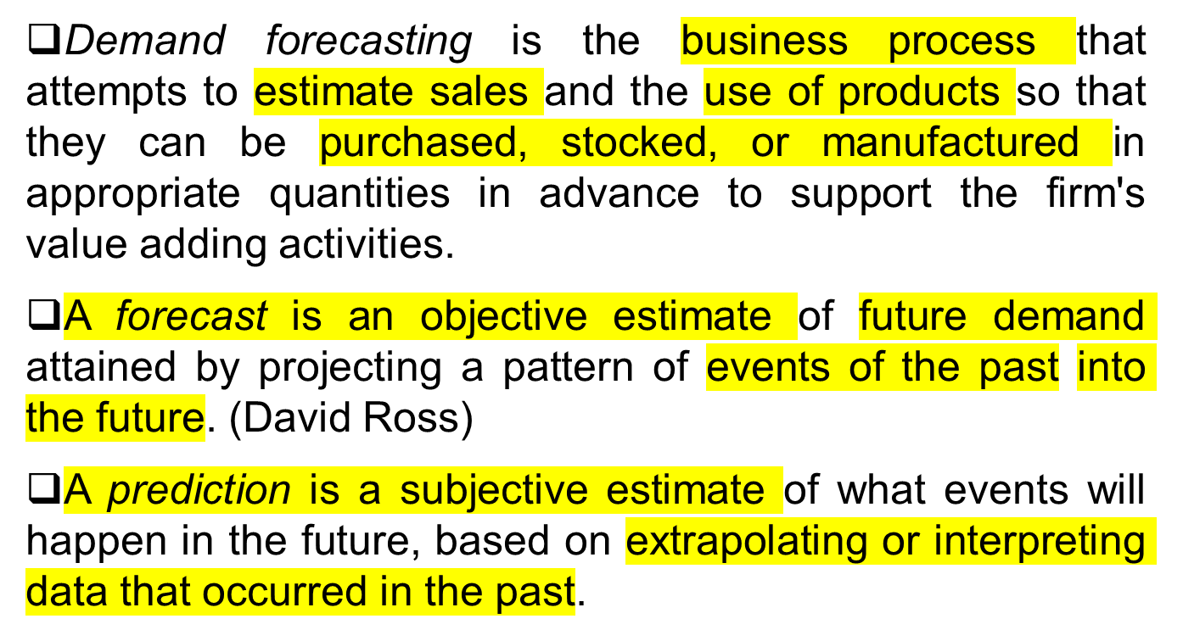
What is Forecasting

Slide 3
Why Demand Forecasting
In general practice, accurate demand forecasts lead to efficient operations and high levels of customer service, while inaccurate forecasts will inevitably lead to inefficient, high cost operations and/or poor levels of customer service.
Forecasts of future demand will determine the quantities that should be purchased, produced, and shipped.
Forecasting helps firm to achieve fast to order cycle time.
Forecast demand also affords the firm opportunities to control costs through leveling its production quantities, rationalizing its transportation, and generally planning for efficient logistics operations.

Slide 4
Features of Forecast
Assume the same underlying causal system.
Forecasts are rarely perfect.
Forecasts for groups of items are more accurate than forecasts for individual items.
Forecast accuracy decreases as the time period covered by the forecast increases.

Slide 5
Elements of a Good Forecast
Timely
Reliable
Accurate
Meaningful
Written
Easy to use

Slide 6
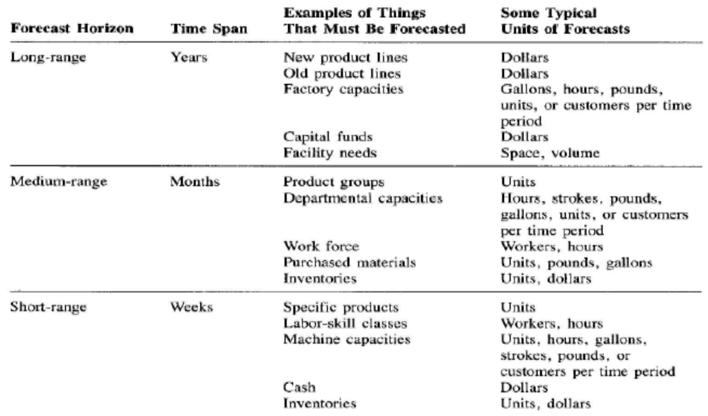
Components of Forecast
Time Frame

Slide 7
Demand Behavior
Trend
  A gradual, long-term up or down movement of demand.
Cycle
  An up-and-down repetitive movement in demand.
Seasonal pattern
  An up-and-down repetitive movement in demand occurring periodically.
Random variations
  Movements in demand that do not follow a pattern.

Slide 8
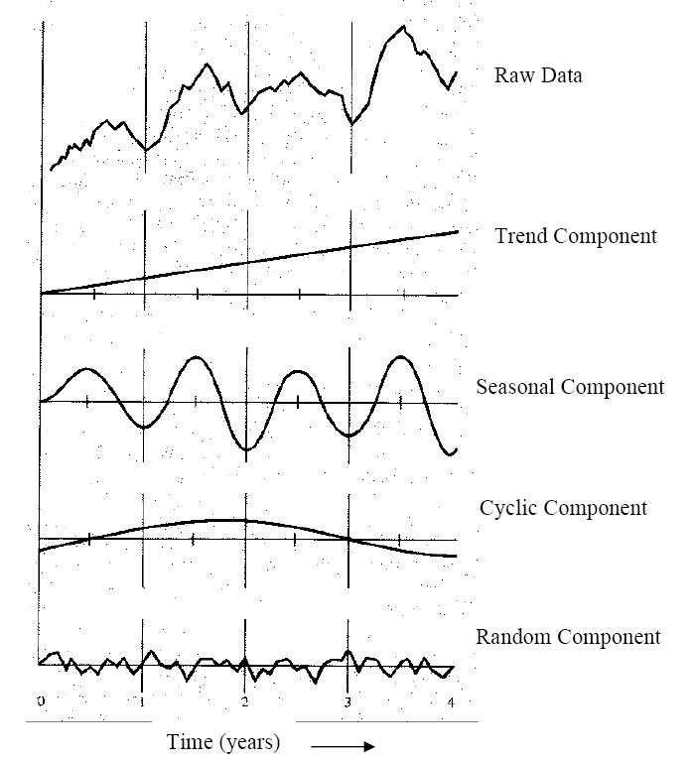
Different Types of Demand Behavior

Slide 9
Approaches to Forecasting
Qualitative
  Use management judgment, expertise, and opinion to predict future demand.
Time series
  Statistical techniques that use historical demand data to predict future demand.
Associative Techniques
  Attempt to develop a mathematical relationship between demand and factors that cause its behavior.

Slide 10
Qualitative Methods
Executive Opinions
Sales force Opinions
Consumer Survey
Delphi Method

Slide 11
Time Series Forecasting
Assume that what has occurred in the past will continue to occur in the future.
Relate the forecast to only one factor – time.
Include
    Naïve method
    Moving average
    Weighted moving average
    Exponential smoothing
    Trend adjusted exponential smoothing
    Linear Trend Model

Slide 12
Naive Method
A naive forecast uses a single previous value of a time series as the basis of a forecast.
The naive approach can be used with a stable series (variations around an average), with seasonal variations, or with trend.
It has virtually no cost, it is quick and easy to prepare because data analysis is nonexistent, and it is easily understandable.
The main objection to this method is its inability to provide highly accurate forecasts

Slide 13
Simple Moving Average
The moving average method uses average demand for a fixed sequence of periods.
This method is used with stable demand with no pronounced behavioral patterns.
n
∑ A_{t-i}
i=1
F_{t} = MA_{n} = -------------
n
F_{t} = Forecast for time period t
MA_{n} = n period moving average
A_{t−i} = Actual value in period t − i
n = Number of periods (data points) in the moving average

Slide 14
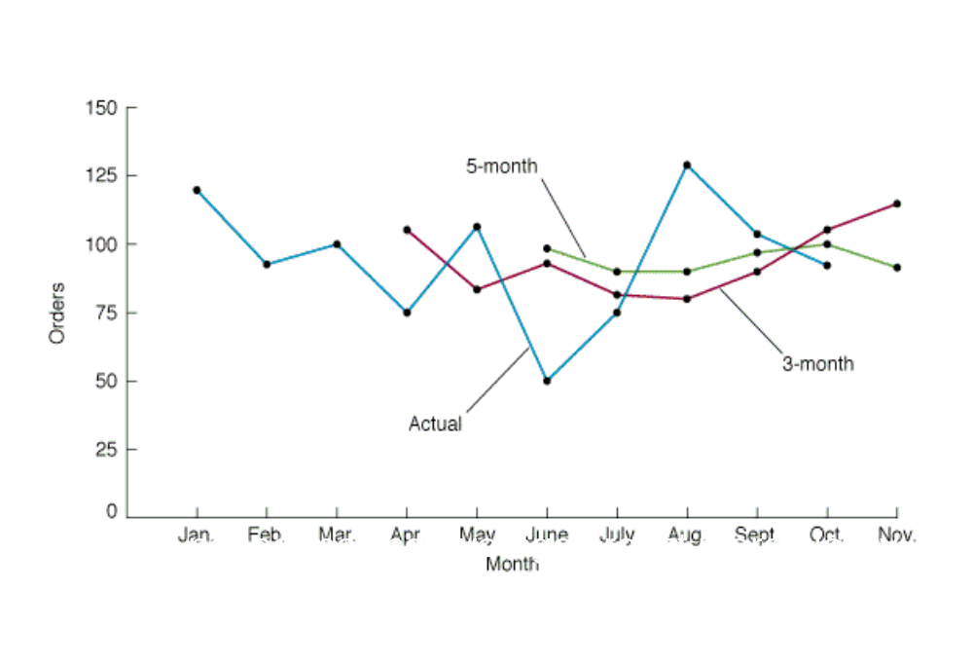

Slide 15
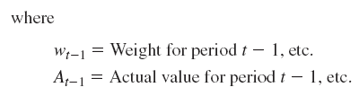
Weighted Moving Average
Place relatively more emphasis on recent data and relatively less emphasis on less current data.

Slide 16
Simple Exponential Smoothing
Averaging method.
Weights most recent data more strongly.
Reacts more to recent changes.
Widely used, accurate method.
F_{t} = F_{t-1} + α(A_{t-1} – F_{t-1})
Where,
F_{t} = Forecast for period t
F_{t−1} = Forecast for the previous period
α = Smoothing constant
A_{t−1} = Actual demand or sales for the previous period

Slide 17
Effect of Smoothing Constant a
Values of a are restricted such that 0 <α< 1.
The choice of α is up to the analyst. In this form, α can be interpreted as the relative weight given to the most recent data
in the series.
If α = 0, then F_{t} = F_{t-1}
Forecast does not reflect recent data
If α = 1, then F_{t} = A_{t-1}
Forecast based only on most recent data
For example, if an α of 0.2 is used, each successive forecast consists of 20% "new" data (the most recent observation) and 80% "old" data, since the prior forecast is composed of recursively weighted combinations of prior observations.

Slide 18
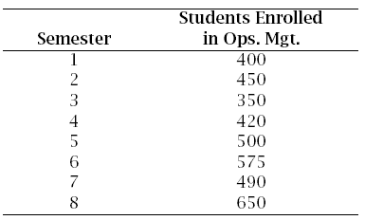
Example#1
The chairperson of the Management Department at UMass Lowell wants to forecast the number of students who will enroll in the Operations Management course next semester in order to determine how many sections to schedule, instructors to allocate, textbooks to order, etc. The chair has compiled the following enrollment data for the past eight semesters:

Slide 19
a. Compute a 3-semester simple moving average forecast for semesters 4 through 8.
b. Compute a 3-semester weighted moving average for semesters 4 through 8 using the weights 0.5, 0.3, and 0.2, with the heavier weights on the more recent semesters.
c. Use exponential smoothing with parameter α = 0.2 and to compute the forecast for semesters 2 through 8. Take F₁ = 400 as the forecast for the first semester.

Slide 20
Semester | Student Enrolled | Moving Avg. | Weighted Moving Avg. | Exponential Smoothing
1 | 400 | 400 | 400 | 400
2 | 450 | 450 | 450 | 400+.2(400-400)= 400.00
3 | 350 | 350 | 350 | 400+.2(450-400)= 410.00
4 | 420 | (400+450+350)/3= 400.00 | (.2×400+.3×450+.5×350)=390.00 | 410+.2(350-410)= 398.00
5 | 500 | (450+350+420)/3= 406.67 | (.2×450+.3×350+.5×420)=405.00 | 398+.2(420-398)= 402.40
6 | 575 | (350+420+500)/3= 423.33 | (.2×350+.3×420+.5×500)=446.00 | 402.4+.2(500-402.4)= 421.92
7 | 490 | (420+500+575)/3=498.33 | (.2×420+.3×500+.5×575)=521.50 | 421.92+.2(575-421.92)= 452.54
8 | 650 | (500+575+490)/3=521.67 | (.2×500+.3×575+.5×490)=517.50 | 452.54+.2(490-452.54)= 460.03

Slide 21
Linear Trend Model
Analysis of trend involves developing an equation that will suitably describe trend.
The trend component may be linear, or it may not.
A simple plot of the data can often reveal the existence and nature of a trend.
F_{t} = a + bt
where,
F_{t} = Forecast for period t
a = Value of F t at t = 0
b = Slope of the line
t = Specified number of time periods from t = 0

Slide 22
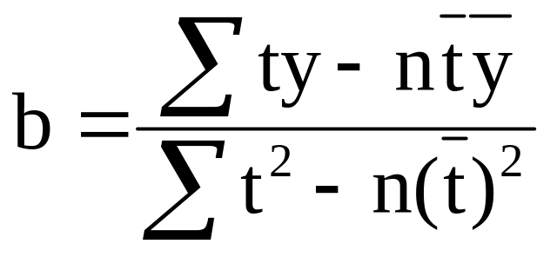
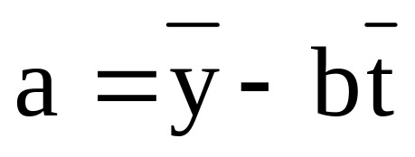
The coefficients of the line, a and b, can be computed from historical
data using these two equations:
where,
n = Number of periods
y = Value of the time series

Slide 23
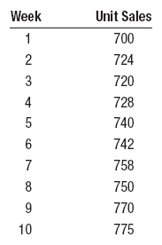
Example 2
Cell phone sales for a California-based firm over the last 10 weeks are shown in the following table.
Plot the data, and visually check to see if a linear trend line would be appropriate.
Determine the trend line equation, and predict sales for weeks 11 and 12.

Slide 24
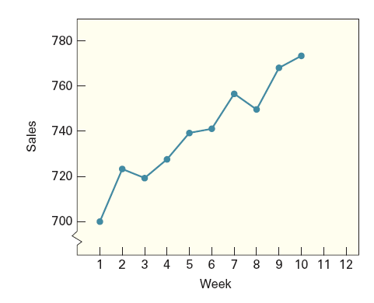

Slide 25



 | Week(t) | Sales(y) | t² | y² | ty
 | 1 | 700 | 1 | 490000 | 700
 | 2 | 724 | 4 | 524176 | 1448
 | 3 | 720 | 9 | 518400 | 2160
 | 4 | 728 | 16 | 529984 | 2912
 | 5 | 740 | 25 | 547600 | 3700
 | 6 | 742 | 36 | 550564 | 4452
 | 7 | 758 | 49 | 574564 | 5306
 | 8 | 750 | 64 | 562500 | 6000
 | 9 | 770 | 81 | 592900 | 6930
 | 10 | 775 | 100 | 600625 | 7750
Sum | 55 | 7407 | 385 | 5491313 | 41358
Mean | 5.5 | 740.7
F_{t}= 699.40+7.51t

Slide 26
Associative Technique: Linear Regression Model
Linear regression model develop a relationship between demand and factors that cause its behavior.
    y = a + bx a = intercept (at period 0)
        b = slope of the line
        x = Independent variable
        y = Dependent variable
Σ xy – n(x)(y)
b = a = y - bx
Σ x² - n(x)²

Slide 27

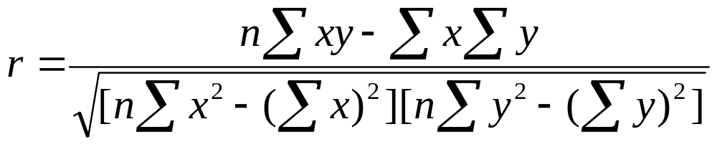
Correlation
Coefficient of correlation, r
  Measure of strength of relationship.
  Varies between -1.00 and +1.00.
Coefficient of determination, r²
  Percentage of variation in dependent variable resulting from changes in the independent variable.

Slide 28
Example 3
Dan Ireland, the student body president at Toledo State University, is concerned about the cost to students of textbooks. He believes there is a relationship between the number of pages in the text and the selling price of the book. To provide insight into the problem he selects a sample of eight textbooks currently on sale in the bookstore. Draw a scatter diagram.
Determine the correlation between the two variables. Does it appear that a relationship between these variables will yield good predictions? Explain.
b. Obtain a linear regression line for the data.
c. Estimate the price of a book with 800 pages.

Slide 29
Book Page Price($)
Introduction to History 500 84
Basic Algebra 700 75
Introduction to Psychology 800 99
Introduction to Sociology 600 72
Business Management 400 69
Introduction to Biology 500 81
Fundamentals of Jazz 600 63
Principles of Nursing 800 93

Slide 30
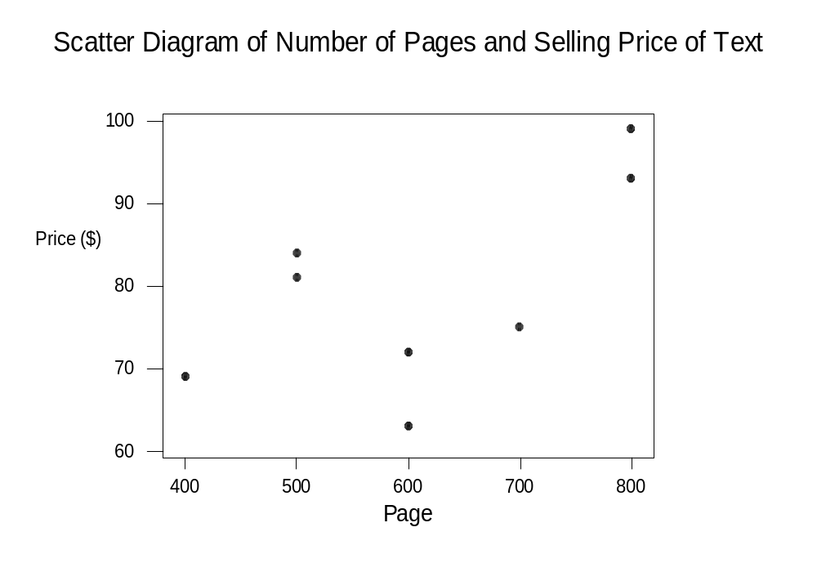

Slide 31
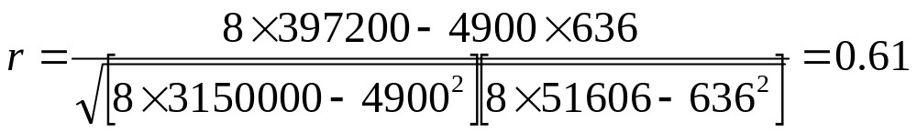
Page (X) | Price (Y) | X² | Y² | XY
500 | 84 | 250000 | 7056 | 42000
700 | 75 | 490000 | 5625 | 52500
800 | 99 | 640000 | 9801 | 79200
600 | 72 | 360000 | 5184 | 43200
400 | 69 | 160000 | 4761 | 27600
500 | 81 | 250000 | 6561 | 40500
600 | 63 | 360000 | 3969 | 37800
800 | 93 | 640000 | 8649 | 74400
∑X=4900 | ∑Y=636 | ∑X²=3150000 | ∑Y²=51606 | ∑XY=397200
Mean X=612.5 | Mean Y=79.5

Slide 32
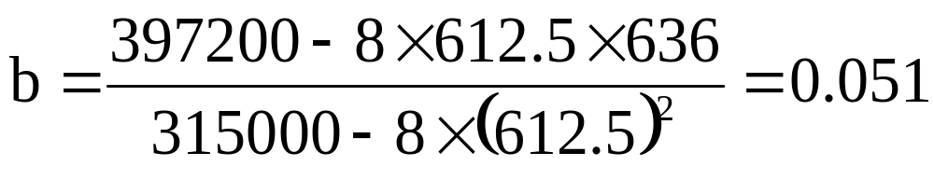
The regression equation is,
Y(Price) = 48.26 + 0.051X(No. of pages)
The price of a 800 page book is,
Price = 48.26 + 0.051×800 =$89.06

Slide 33
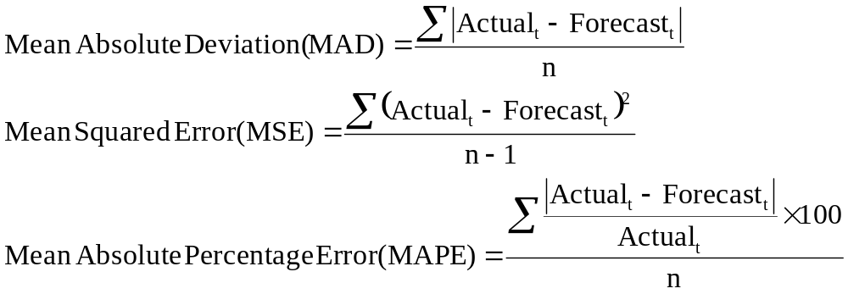
Forecast Accuracy

Slide 34
Example 4
Referring to example 1, compute MAD, MSE, and MAPE for the moving average method.
Semester | Student Enrolled | Moving Avg
1 | 400 | 400
2 | 450 | 450
3 | 350 | 350
4 | 420 | 400.00
5 | 500 | 406.67
6 | 575 | 423.33
7 | 490 | 498.33
8 | 650 | 521.67

Slide 35
Semester | Student Enrolled | Moving Avg | error | Absolute error | error² | %error
1 | 400 | 400 | 0 | 0 | 0 | 0
2 | 450 | 450 | 0 | 0 | 0 | 0
3 | 350 | 350 | 0 | 0 | 0 | 0
4 | 420 | 400.00 | 20 | 20 | 400 | 4.76
5 | 500 | 406.67 | 93.33 | 93.33 | 8710.49 | 18.67
6 | 575 | 423.33 | 151.67 | 151.67 | 23003.79 | 26.38
7 | 490 | 498.33 | -8.33 | 8.33 | 69.39 | 1.7
8 | 650 | 521.67 | 128.33 | 128.33 | 16468.59 | 19.74
SUM |  |  |  | 401.66 | 48652.26 | 71.25

Slide 36
Moving Avg
MAD= 401.66/8 = 50.21
MSE= 48652.26/7 = 6950.32
MAPE= 71.25/8 = 8.91%
Weighted Moving Avg
MAD= 418/8 = 52.25
MSE= 45216/7 = 6459.43
MAPE= 75.36/8 = 9.42%
Exponential Smoothing
MAD= 560.11/8 = 70.01
MSE= 74535.09/7 = 10647.87
MAPE= 105.39/8 = 13.17%

Slide 37
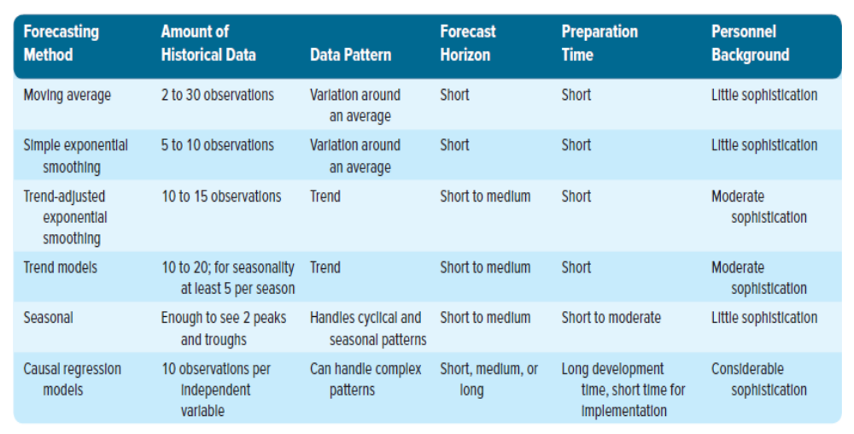
Choosing An Appropriate Forecasting Technique

